Slide 1

Customer Experience Analysis
Mohammad Sadegh Mirshamsi Junior Data Analyst
October 2025 Contact: msmmirshamsi@gmail.com

Slide 2

Dataset Overview
Identification & Context Data
Unique ID of each customer Date of customer interaction
200 Unique IDs
1 Interactions per Customer

Slide 3
Dataset Overview
2024-10-25 to 2025-04-25 Data range
Identification & Context Data
Unique ID of each customer Date of customer interaction
4
Max Daily Interactions
1 Min Daily Interactions
1.52
Avg Daily Interactions

Slide 4
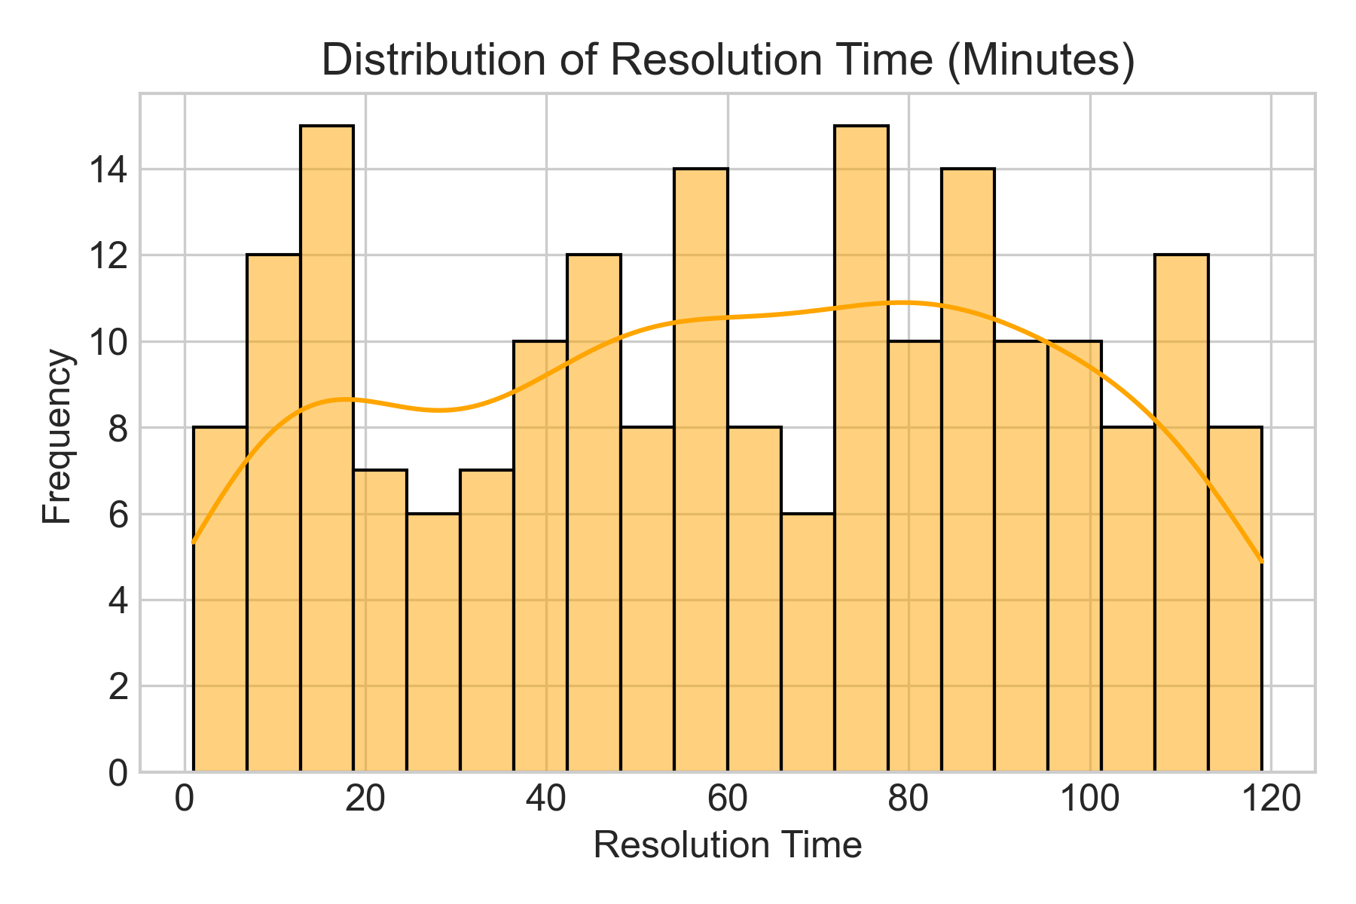
Dataset Overview
Interaction & Performance Metrics
Time taken to resolve the issue Category of reported issue Channel used (call, chat, email, etc.)
60.69 Avg Resolution Time
49.5
Resolved Quickly%(under 60 min )

Slide 5
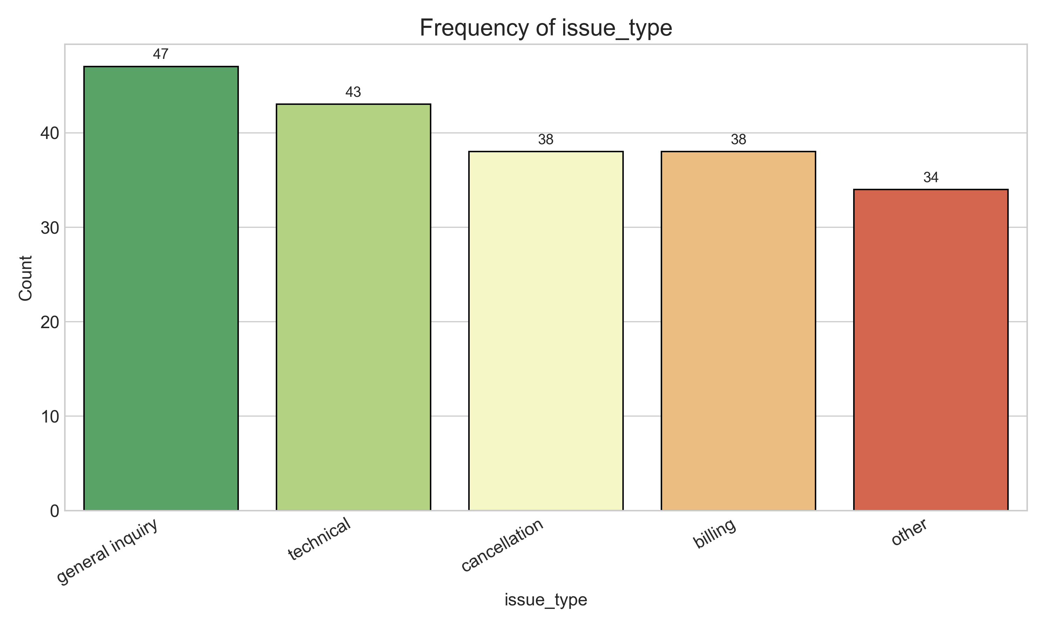
Dataset Overview
Interaction & Performance Metrics
Time taken to resolve the issue Category of reported issue Channel used (call, chat, email, etc.)

Slide 6
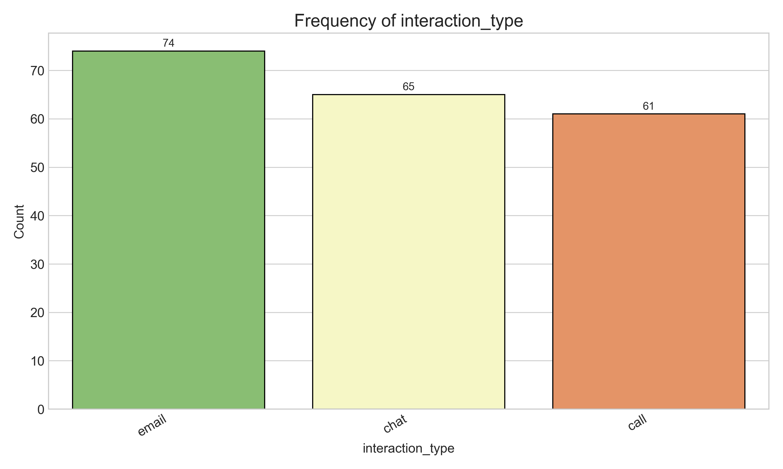
Dataset Overview
Interaction & Performance Metrics
Time taken to resolve the issue Category of reported issue Channel used (call, chat, email, etc.)

Slide 7

Dataset Overview
Feedback & Sentiment Data
Short text excerpt from the conversation Customer rating (1 to 5)

Slide 8
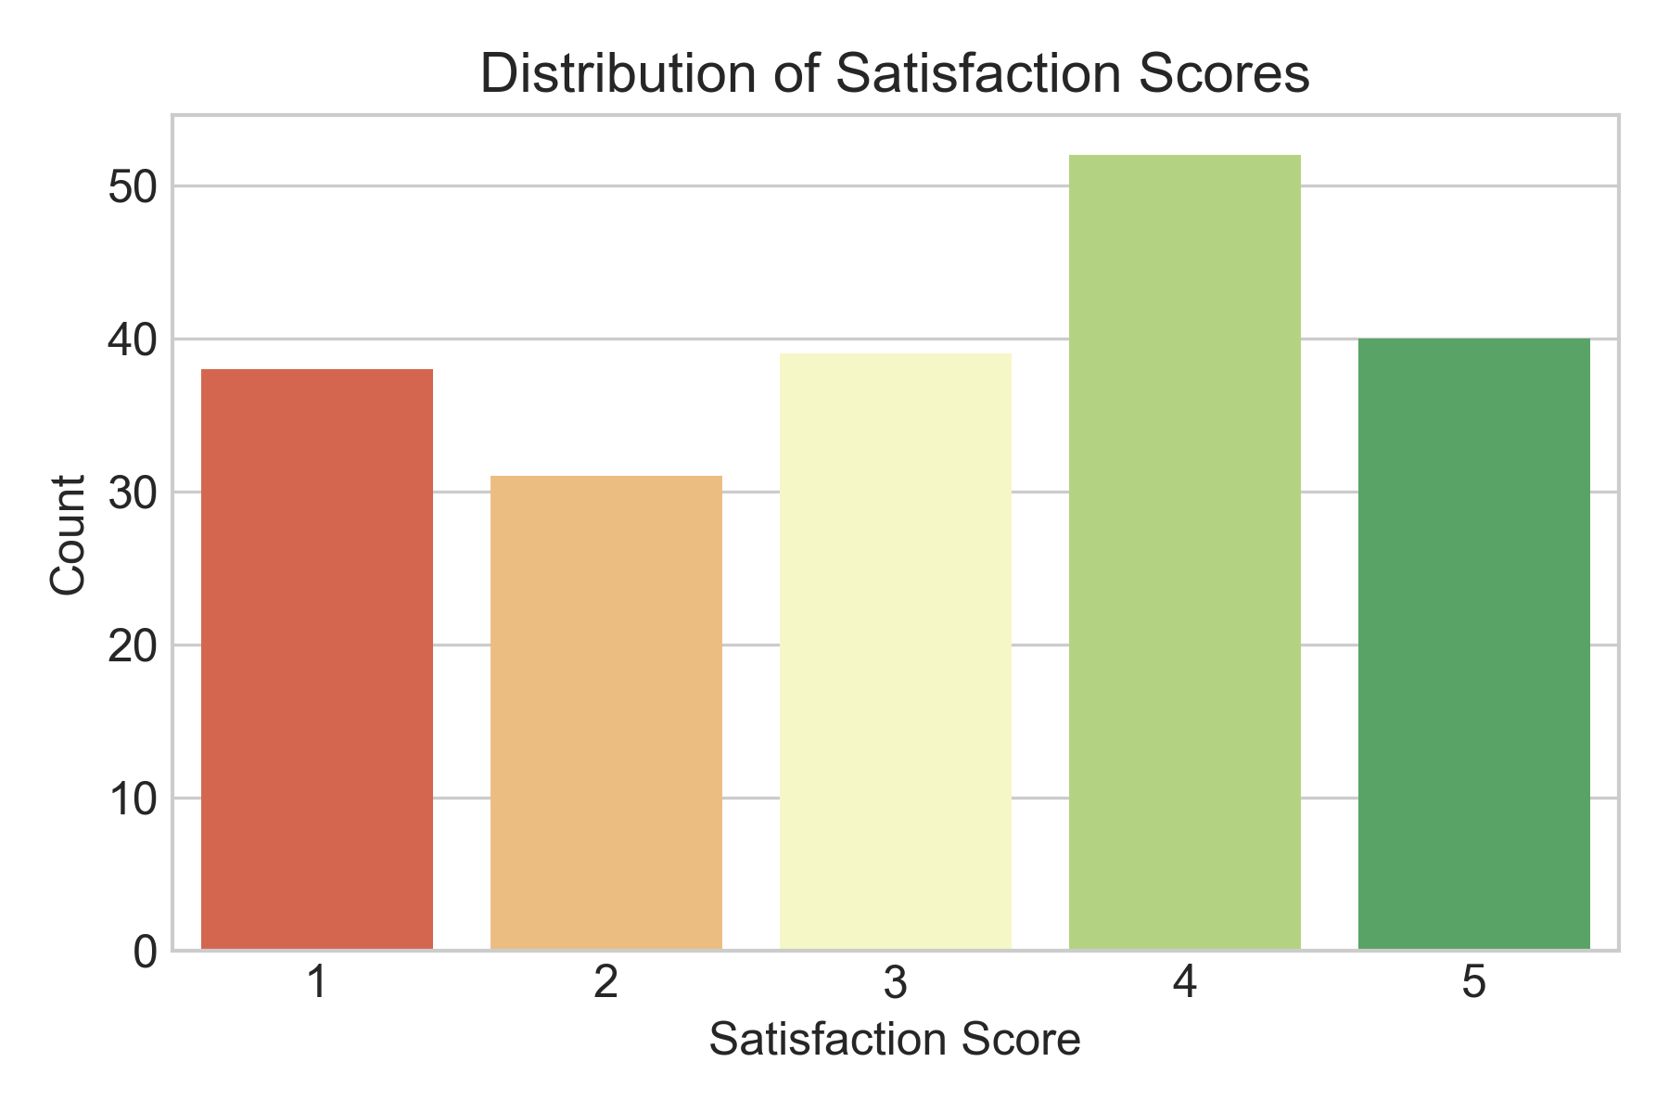
Dataset Overview
Feedback & Sentiment Data
Short text excerpt from the conversation Customer rating (1 to 5)
3.13 Avg Satisfaction
0.46 overall satisfaction%
0.35 overall Disatisfaction%

Slide 9
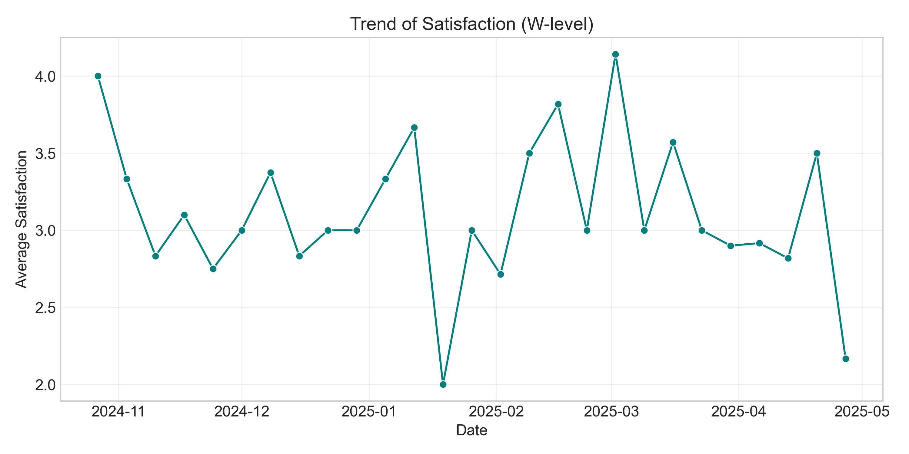
Dataset Overview
Feedback & Sentiment Data
Short text excerpt from the conversation Customer rating (1 to 5)

Slide 10
Data Gaps
Customer Demographics
Age
Gender
Customer Segment
location
Agent Details
Agent ID
Team
Experience Level
Performance Metrics
Resolution Efficiency
Resolution Outcome
Issue Resolved
Follow-Up Needed
Escalation Rate
First Contact Resolution
Customer History
Total Past Interactions
Loyalty Level
Retention Metrics
Frequency of Complaints

Slide 11
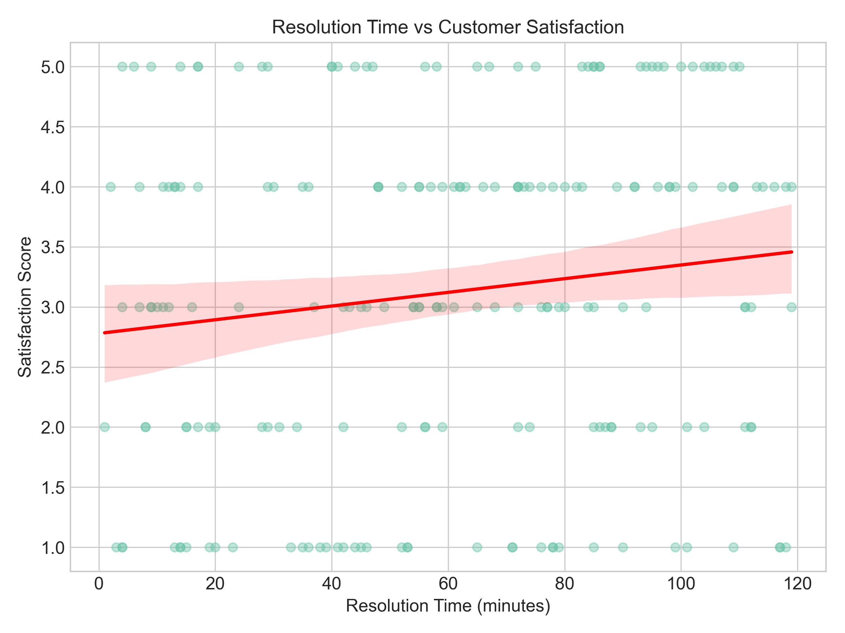
Key Insights
Insight 1: Relationship Between Resolution Time and Customer Satisfaction
0.141
Spearman
0.138
Pearson
0.0464
p-value

Slide 12
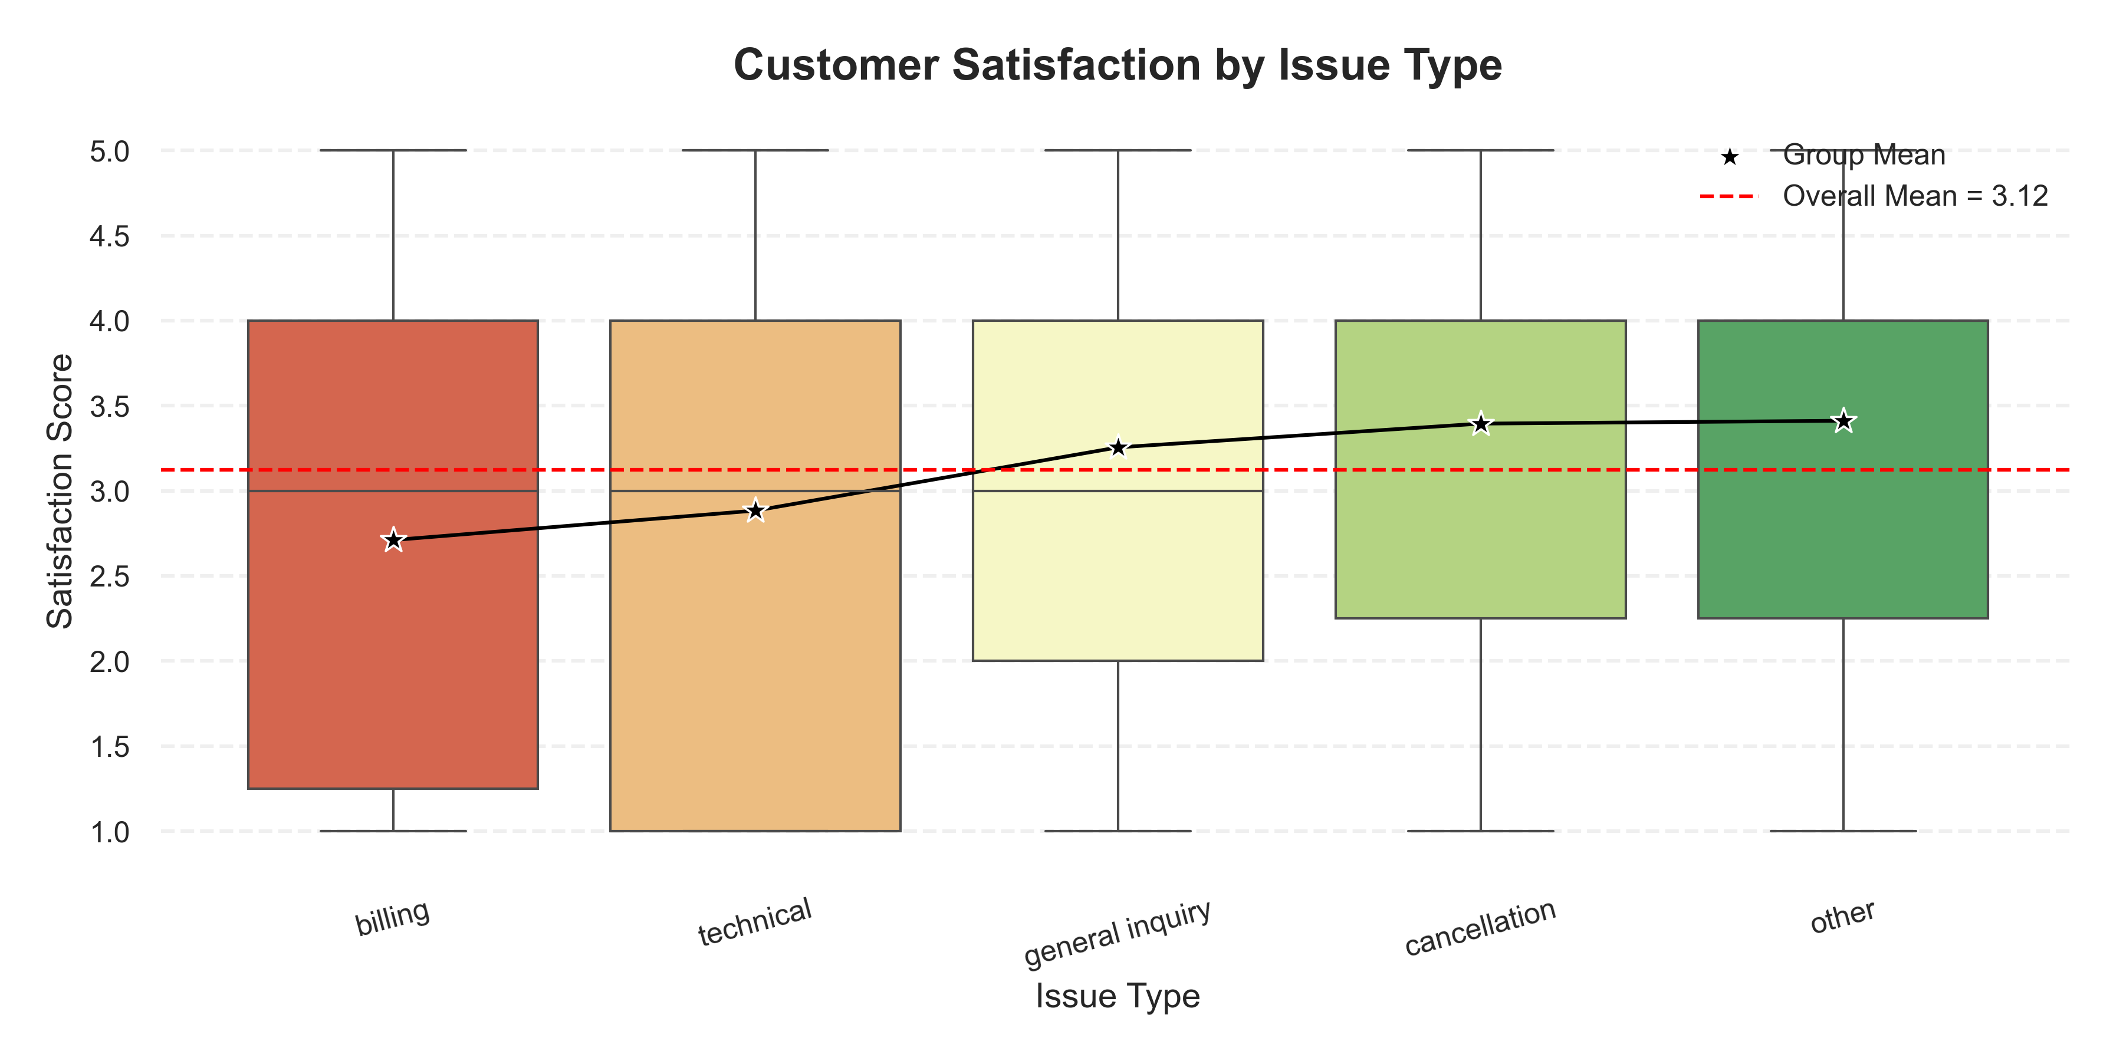
Key Insights
Insight 2: Issue Type and Its Impact on Customer Satisfaction
0.1031
p-value

Slide 13
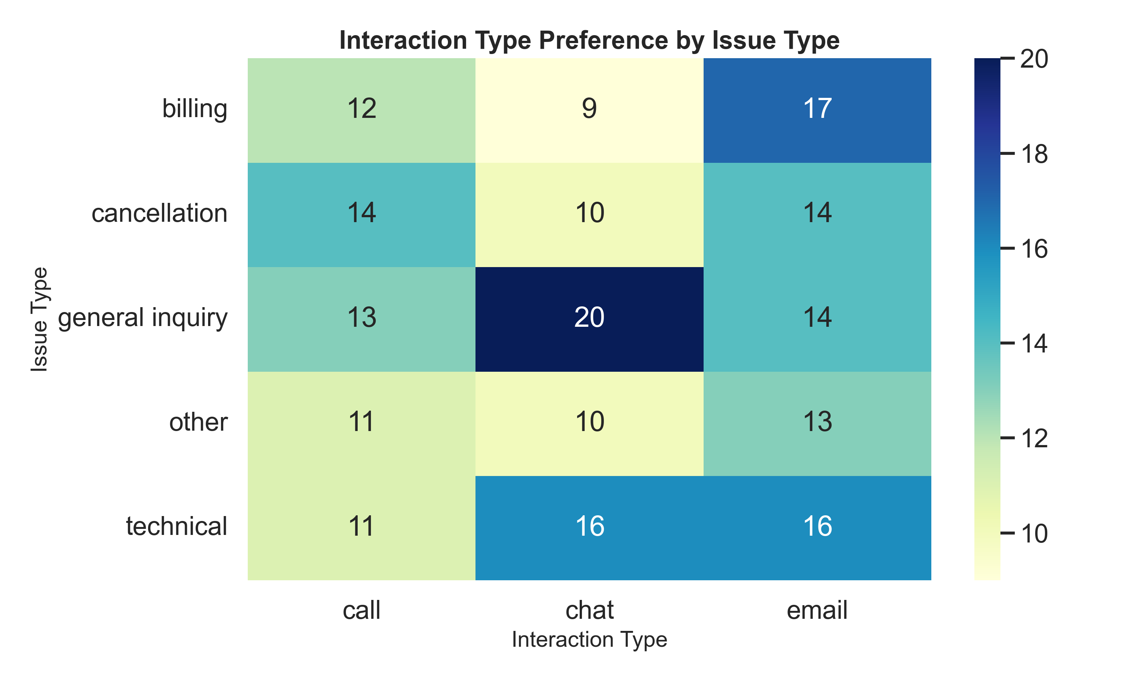
Key Insights
Insight 3: Communication Channel Preferences by Issue Type
0.7
p-value

Slide 14
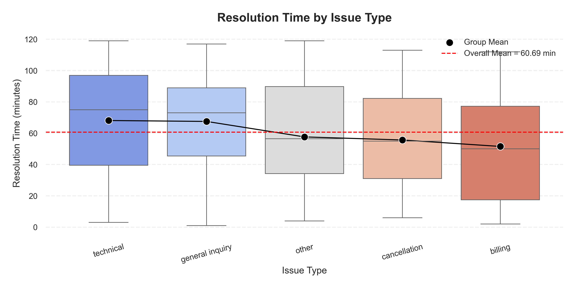
Key Insights
Insight 4: Resolution Time by Issue Type
0.106
p-value

Slide 15
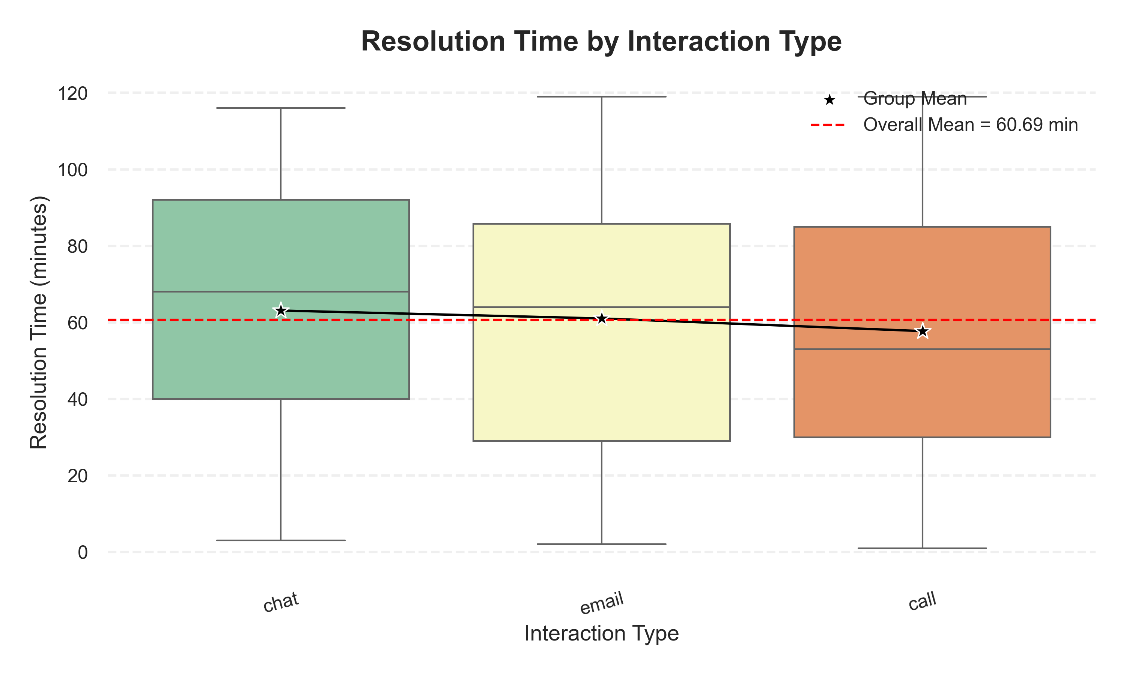
Key Insights
Insight 5: Resolution Time by Communication Channel
0.65
p-value

Slide 16
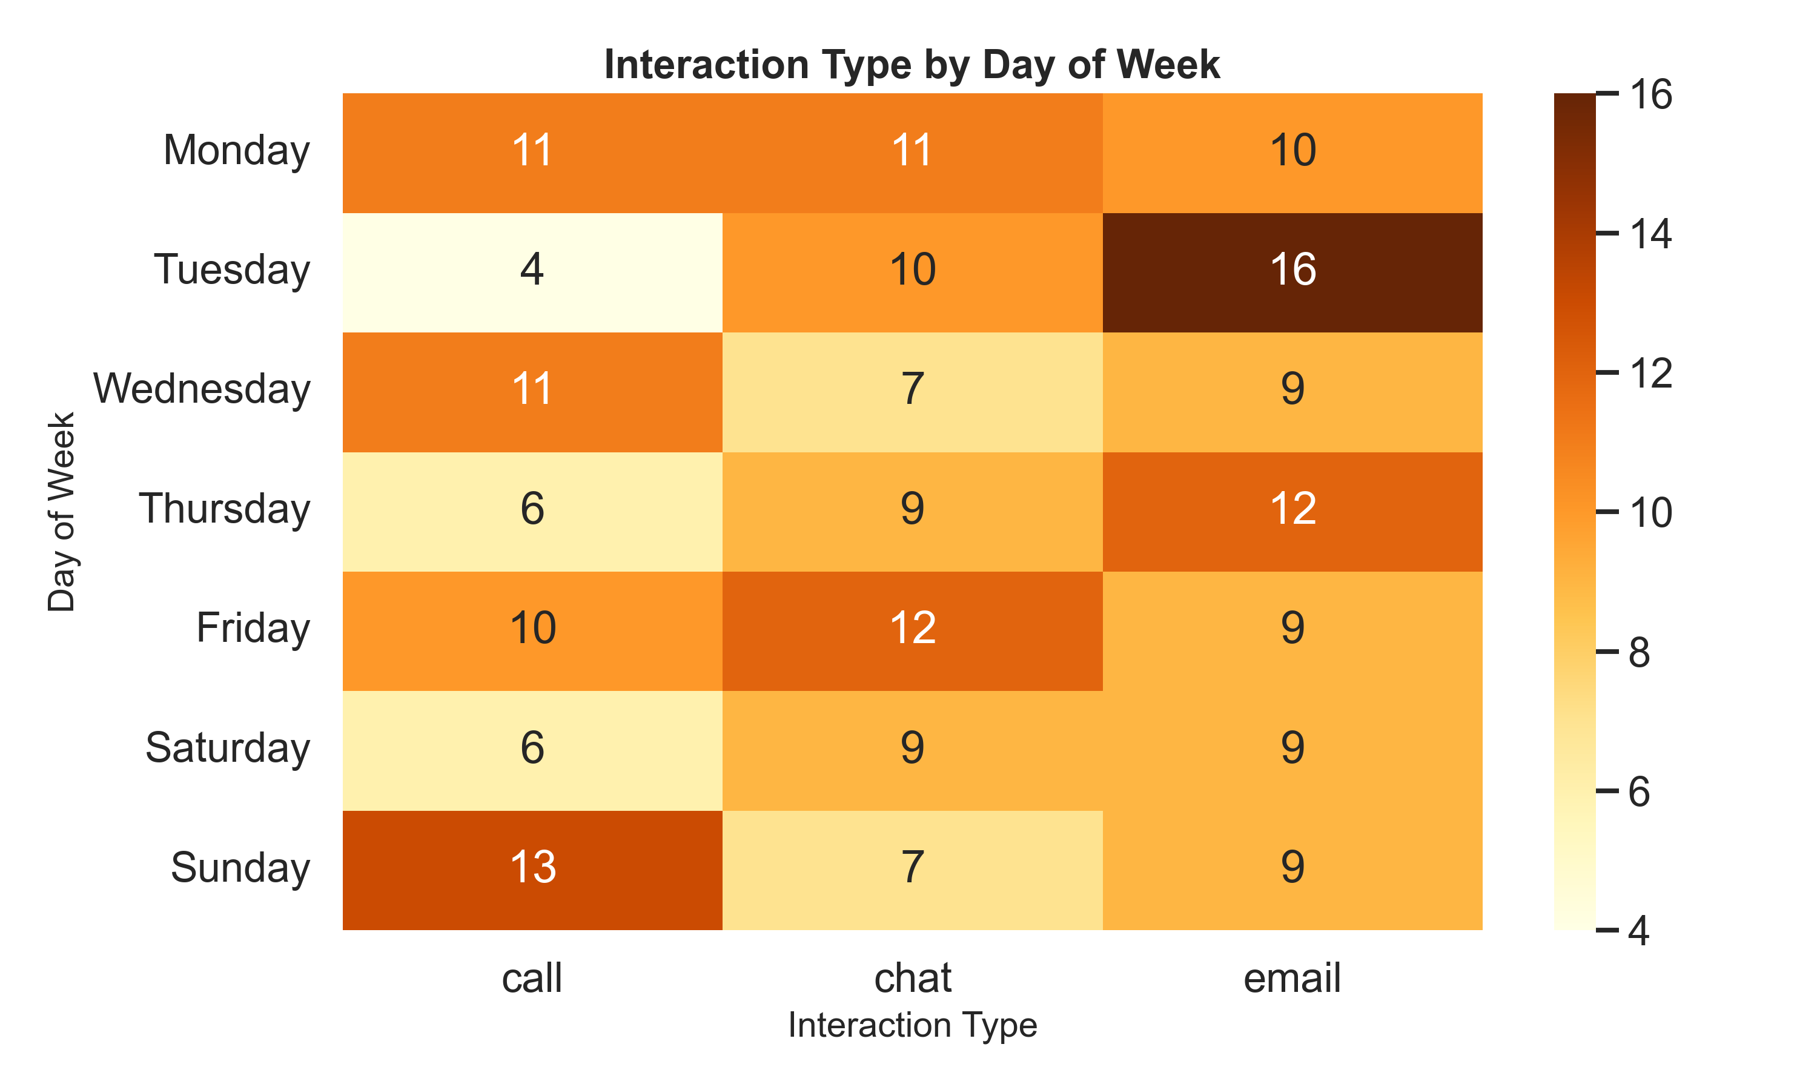
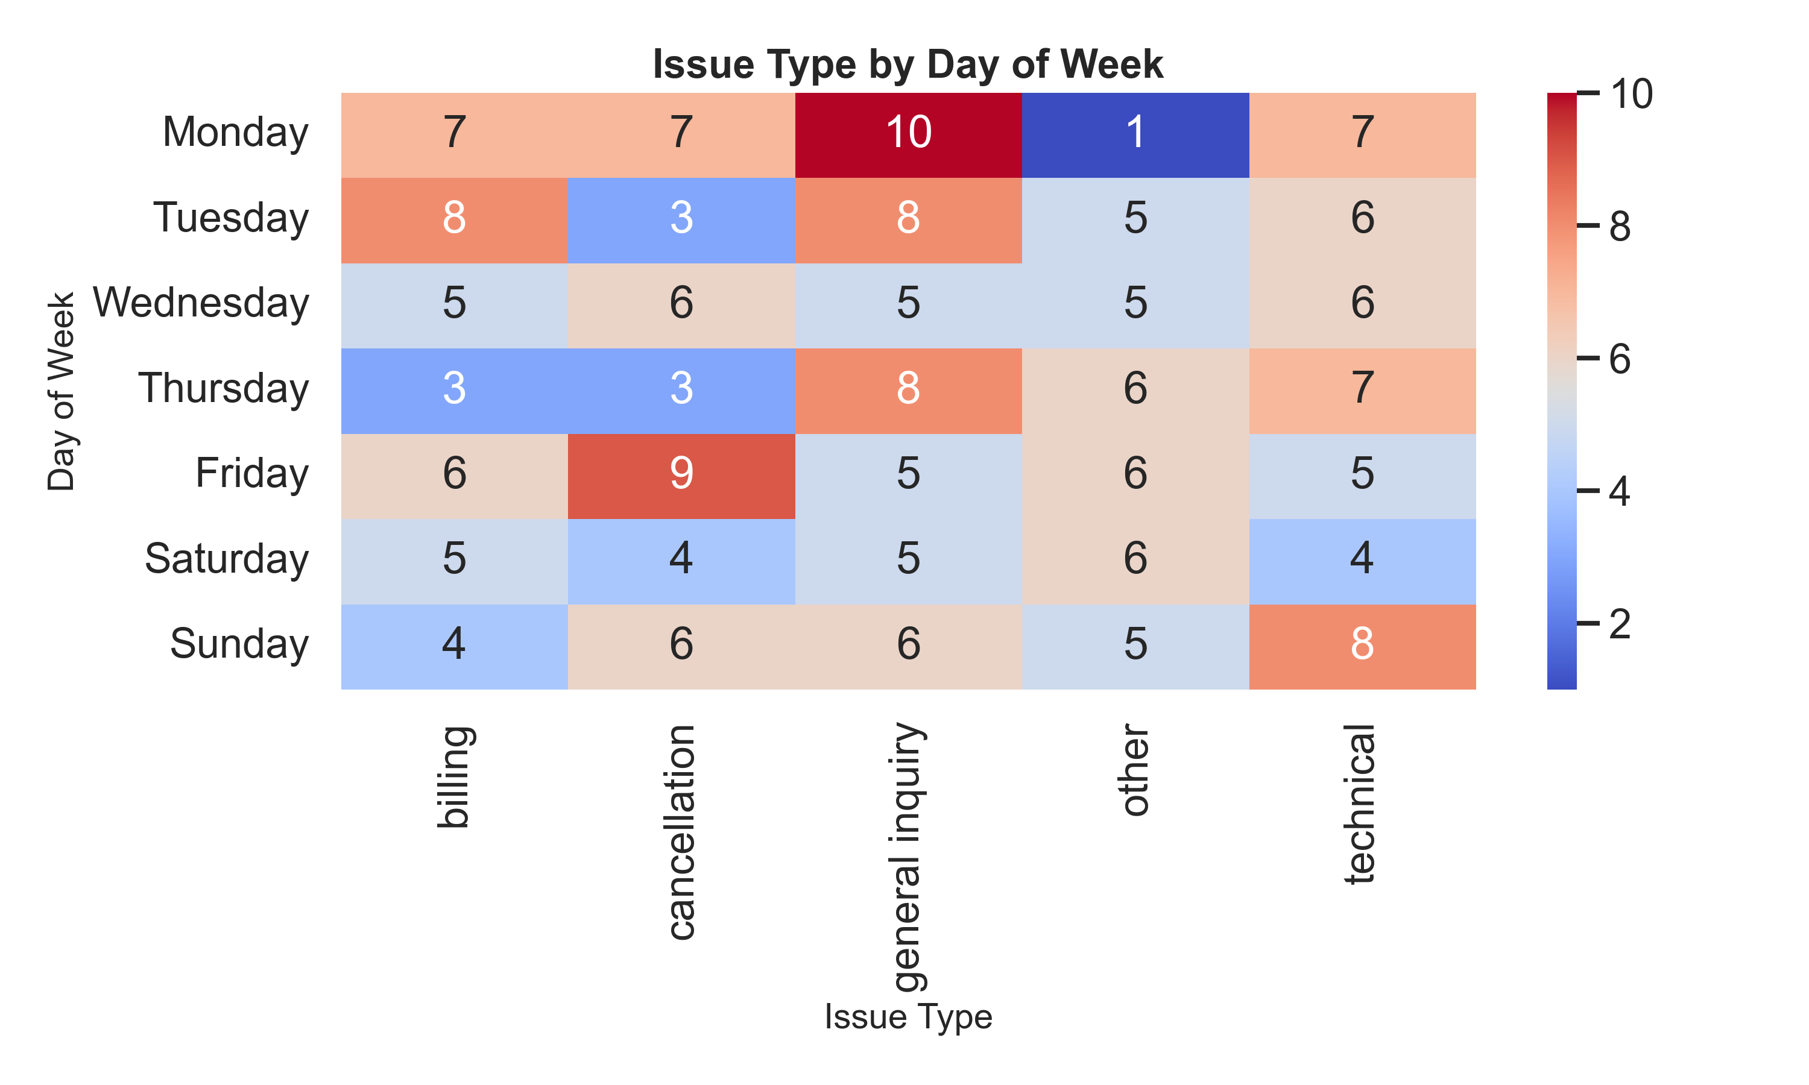
Key Insights
Insight 6: Distribution of Issue Types and Channels Across Weekdays

Slide 17
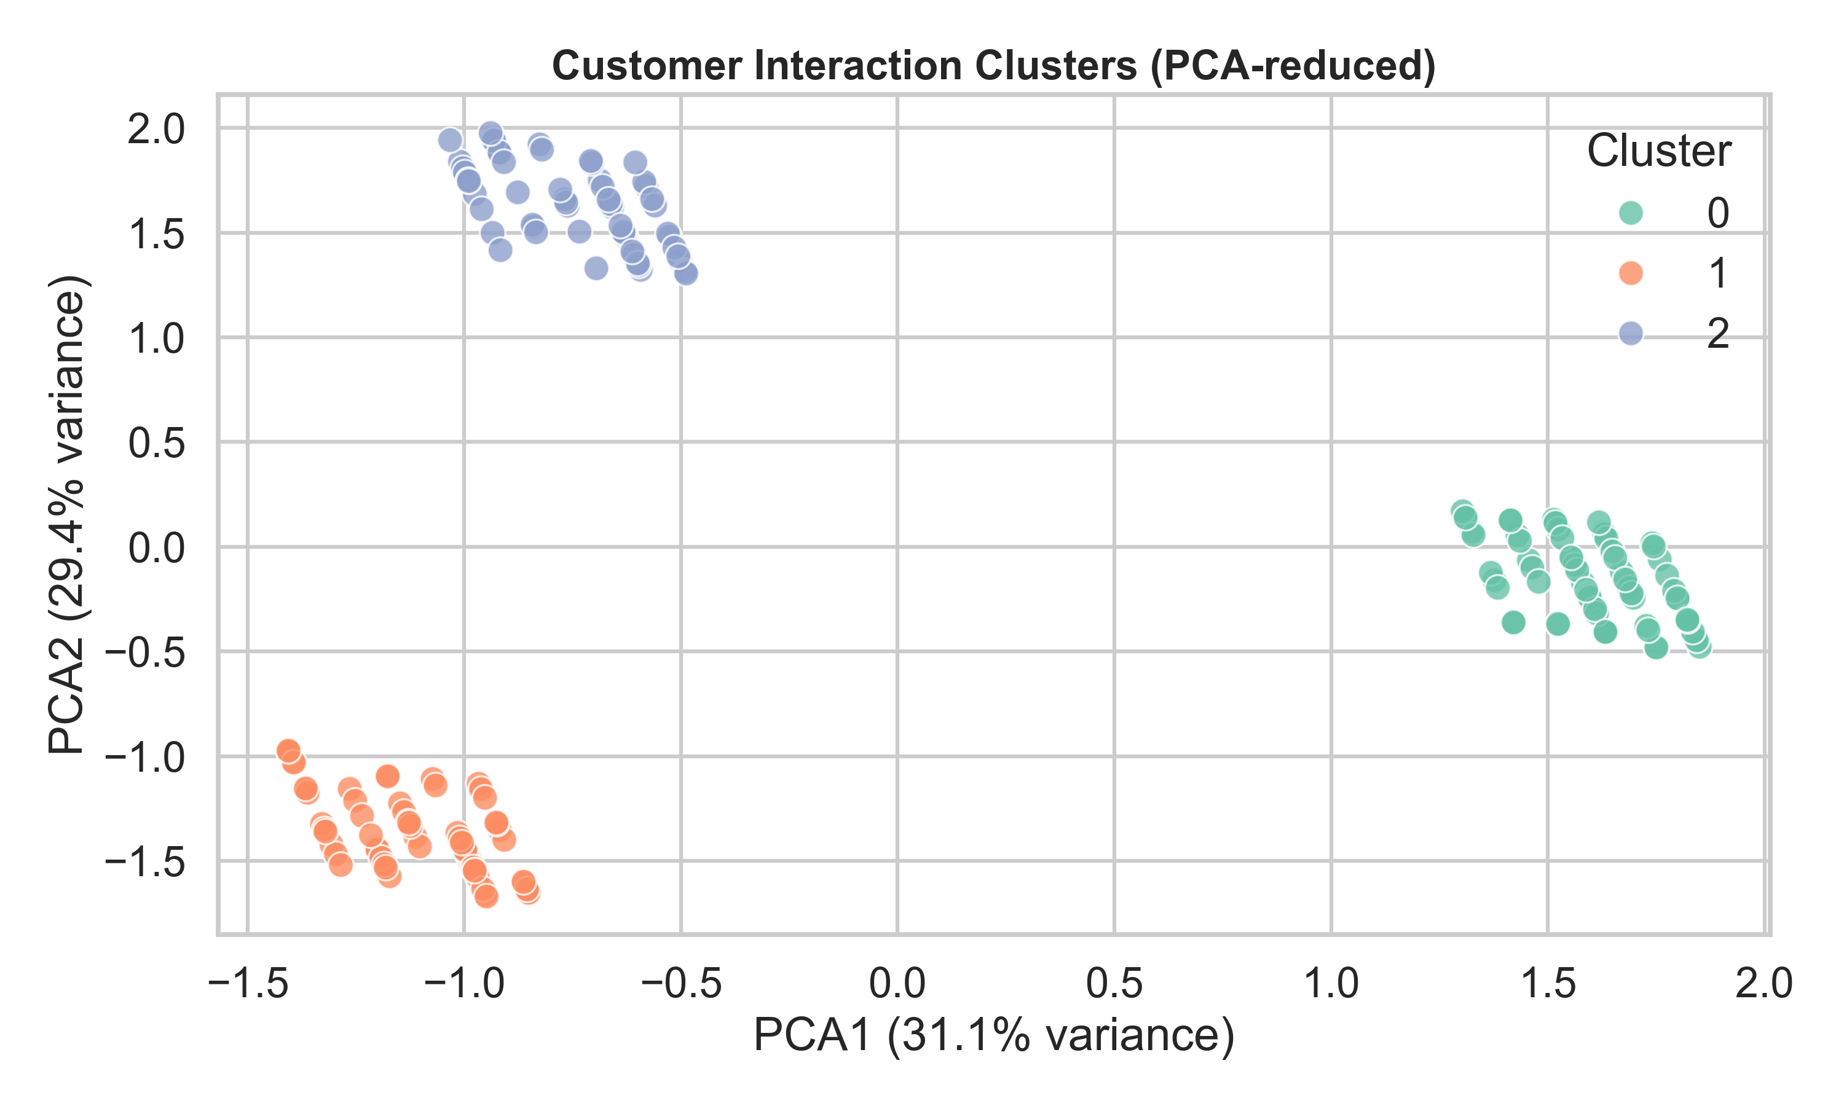
Key Insights
Insight 7: Customer Segmentation by Satisfaction and Response Speed
Cluster | 0 | 1 | 2
Res. Time | 61.03 | 63.09 | 57.07
Customers | 74 | 65 | 61
Avg.Interactions | 1 | 1 | 1
Satisfaction | 3.24 | 3.05 | 3.07

Slide 18
Satisfaction Prediction
Problem Type: Binary Classification
Low/Unsatisfied → 0
Medium/High Satisfaction → 1
Algorithm
Logistic Regression with GridSearchCV

Slide 19
Satisfaction Prediction
Text Cleaning
Text Preprocessing Steps
Remove noise: links, mentions, numbers, special characters (Regex)
Normalize Persian text («ی» → «ي», «ک» → «ك»)
Tokenization using Hazm library
Remove stopwords ( «که» ,«در», «از»)

Slide 20
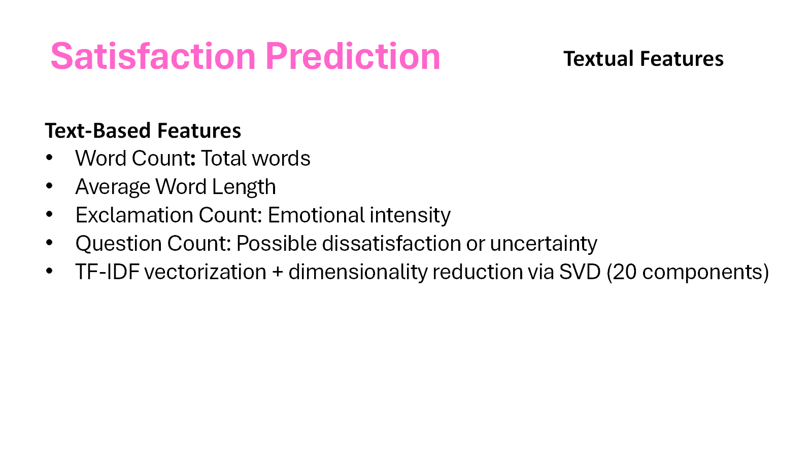

Slide 21
Satisfaction Prediction
Temporal Feature Extraction
Temporal Features
Extracted from interaction_date column:
Day → Day of the month
Month → Month number
Year → Year of interaction
Quarter → Seasonal trend (Q1–Q4)
Binary Indicator: is_holiday → Detects official holidays & Fridays

Slide 22
Satisfaction Prediction
Categorical Feature Encoding
Features:
interaction_type → Type of interaction (chat, call, email, etc.)
issue_type → Type of issue reported
Encoding: One-Hot Encoding applied to convert categories into numeric vectors
Purpose: Enable model to process categorical data effectively

Slide 23
Satisfaction Prediction
Model Performance Metrics
Class | F1-score | Recall | Precision
0 | 0.73 | 0.77 | 0.70
1 | 0.61 | 0.61 | 0.65
Accuracy: 69%
Observation: Model detects dissatisfaction more effectively than high satisfaction

Slide 24

WordCloud

